Slide 1
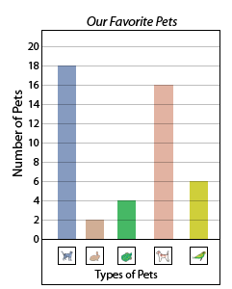
With your learning partner:
Which pet was the most popular?
Which pet was the least popular?
What is the total for rabbits and tortoises?
What is the difference between dogs and budgies?

